Slide 1



Dayananda sagar college of engineering DEPARTMENT OF ELECTRONICS AND TELECOMMUNICATION ENGINEERINg AUTOMATED AMBULANCE DETECTION AND SMART TRAFFIC CONTROL USING CNN Abhilash S - 1ds20et001 Arunkumar s nandi - 1ds20et011 chethan m n - 1ds20et018 chirag n raj - 1ds20et019
GUIDE: DR. SANTHOSH B
Assistant Professor
2023 - 24

Slide 2
01
ABSTRACT

Slide 3
Increasing traffic congestion hampers emergency response times for ambulances.
Manual traffic control systems may delay emergency vehicles, risking lives.
Develop an automated system to detect ambulances in real-time.
Implement a traffic control mechanism to prioritize ambulance routes.

Slide 4
02
OBJECTIVES

Slide 5
Develop a deep learning model to accurately detect ambulance inside the traffic.
Develop an app to find the nearest hospitals around the place where incident occured.
Design a model of a traffic junction to demonstrate the working of the system
Deploying the system on appropriate hardware, such as a Raspberry Pi, to enable real-time ambulance detection in resource-constrained environments

Slide 6
03
COMPONENTS

Slide 7
SOFTWARE REQUIREMENTS
PYTORCH
YOLO ALGORITHM
It is a popular and influential object detection algorithm in the field of computer vision and deep learning.
PyTorch provides a comprehensive ecosystem for building and deploying machine learning and deep learning models.
FLUTTER
Mobile application frameworks used to make development quicker and more efficient.

Slide 8
HARDWARE REQUIREMENTS
RASPBERRY PI
CAMERA
Broadcom BCM2711 quad-core Cortex-A72 (ARM v8) 64-bit SoC @ 1.5GHz
4GB LPDDR4-3200 SDRAM
Continuous monitoring of traffic and gives input to the Raspberry pi. (Fingers 1080 Hi-Res Webcam, Full HD 1920x1080 @30fps)
RESISTORS,
LEDs,
BREAD BOARD etc.,

Slide 9
04
METHODOLOGY

Slide 10
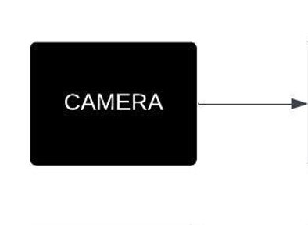
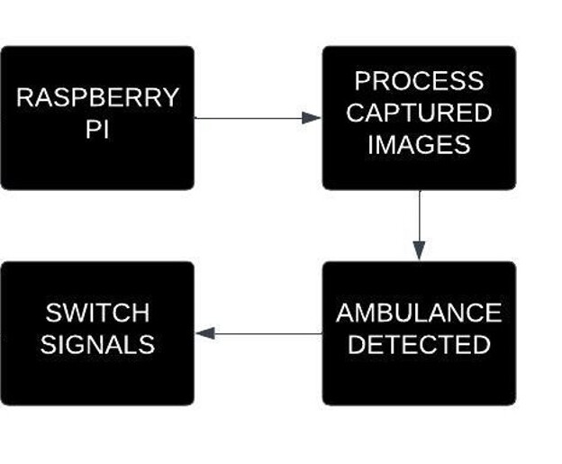
BLOCK DIAGRAM

Slide 11
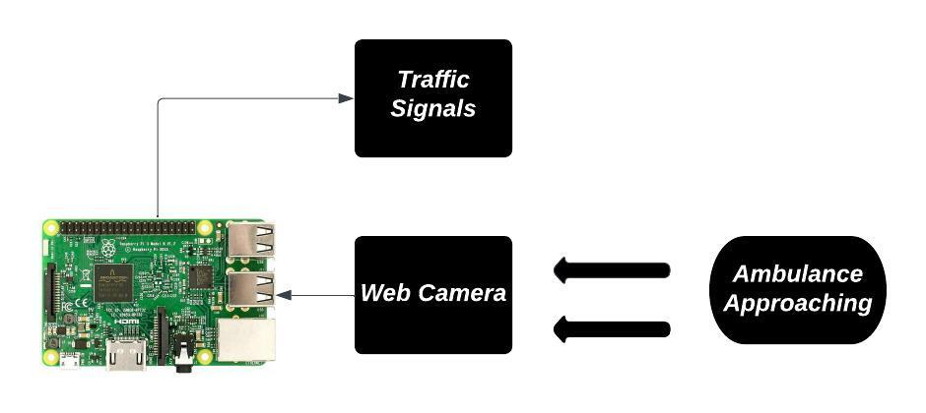
ARCHITECTURE DIAGRAM

Slide 12
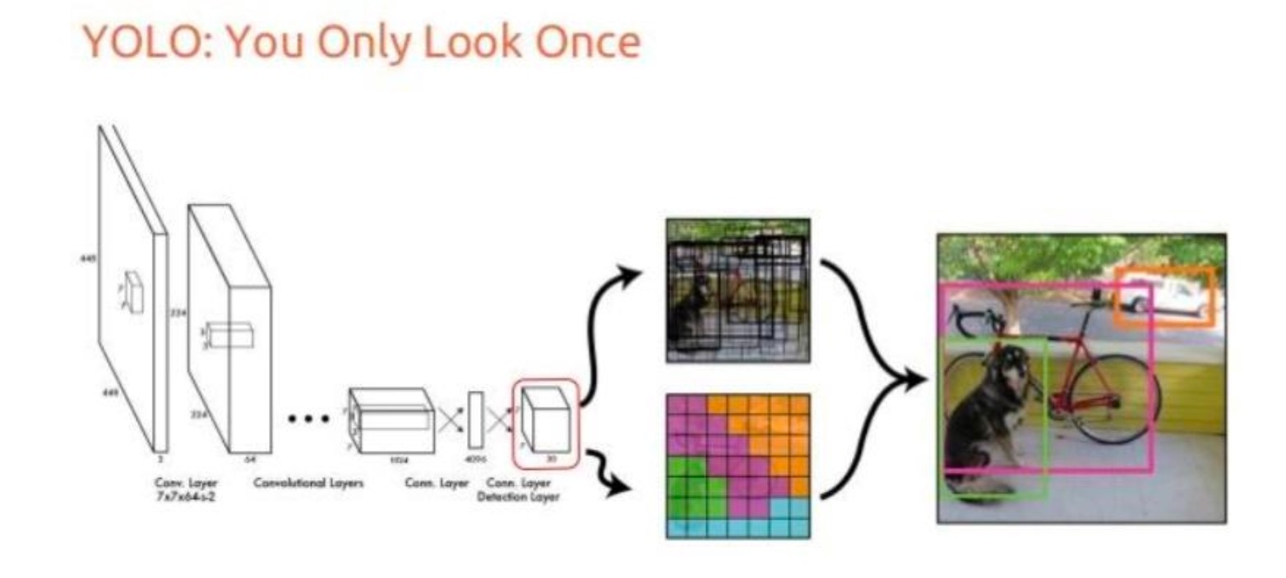
YOLO ALGORITHM

Slide 13
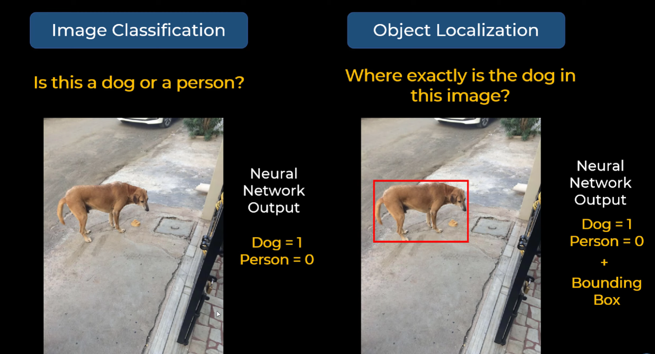
YOLO ALGORITHM

Slide 14
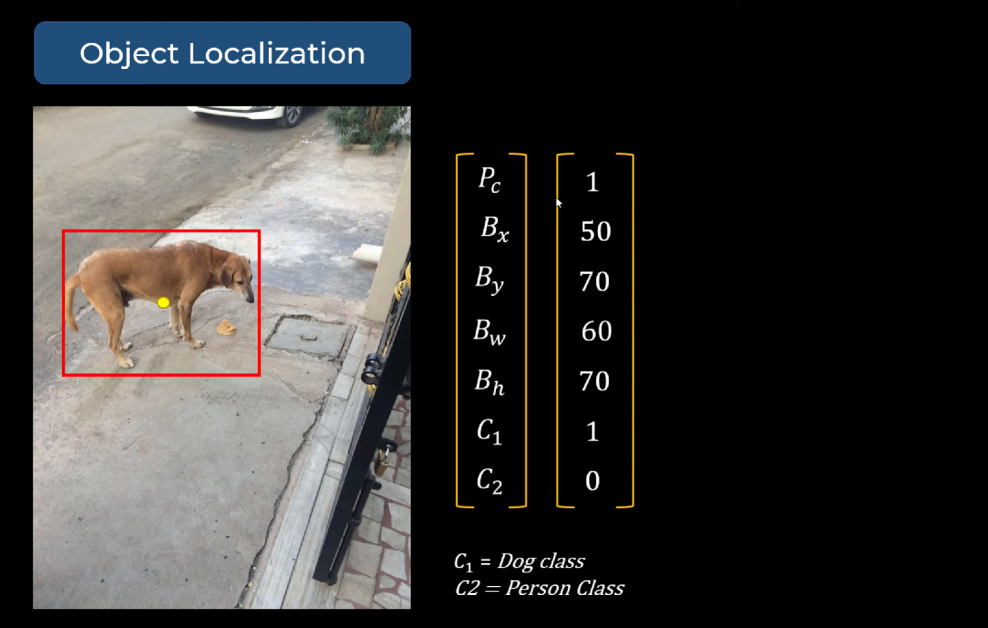
YOLO ALGORITHM

Slide 15
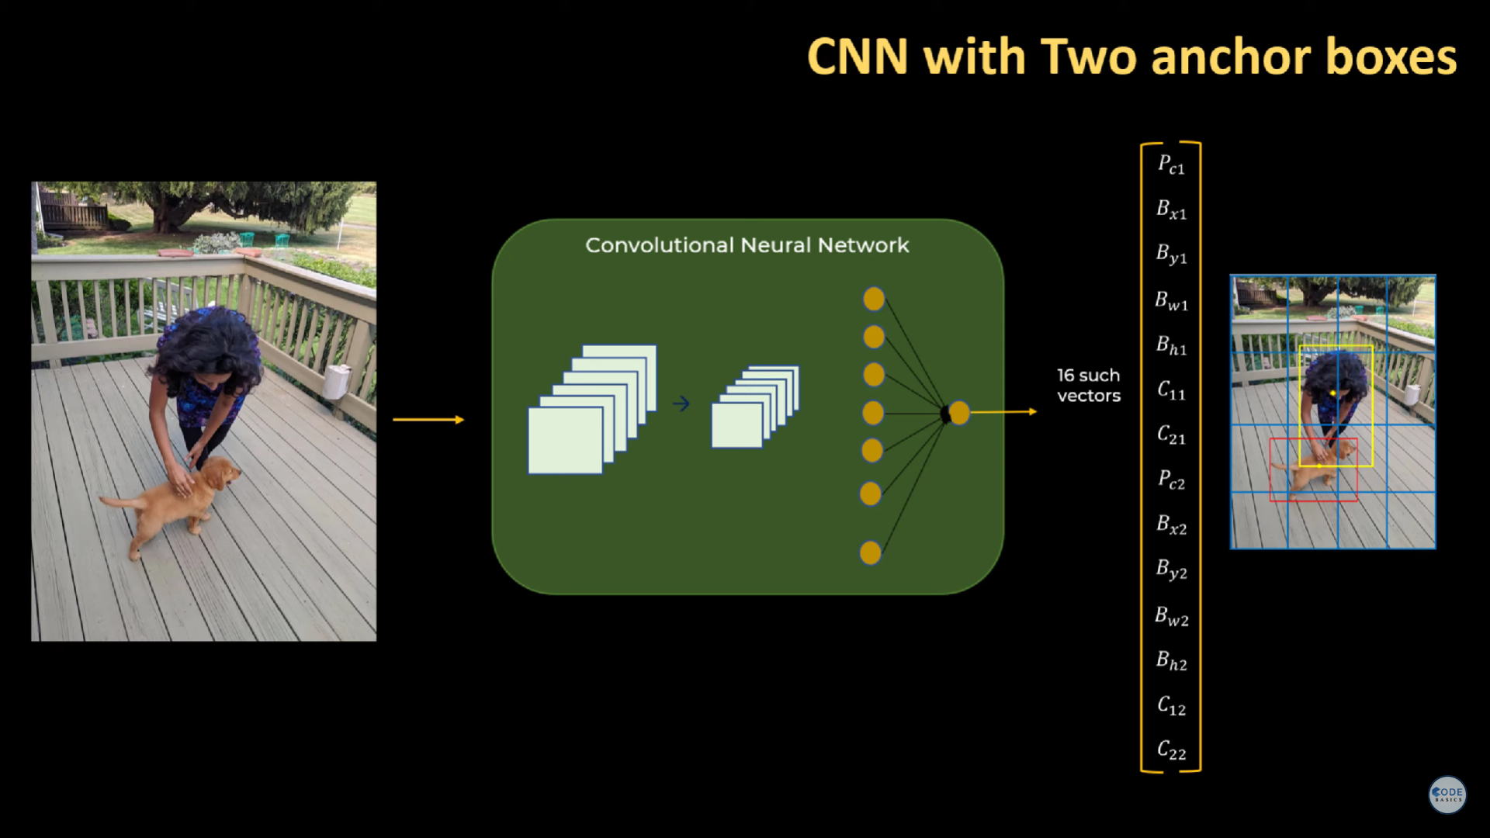
YOLO ALGORITHM

Slide 16
YOLO is a real-time object detection system that processes images in a single pass.
It performs object detection and localization simultaneously.
Typically employs a convolutional neural network (CNN) backbone.
Widely used in various applications such as autonomous driving, surveillance, and image understanding.

Slide 17
05
APPLICATIONS

Slide 18
Integration with smart city initiatives enables seamless coordination between emergency services, traffic management systems, and public transportation.
Object detection technology can be leveraged for broader urban planning, such as optimizing public transit routes or identifying areas prone to traffic bottlenecks.
Automated traffic control ensures smooth passage for emergency vehicles, minimizing delays caused by congestion.

Slide 19
06
OUTPUT

Slide 20
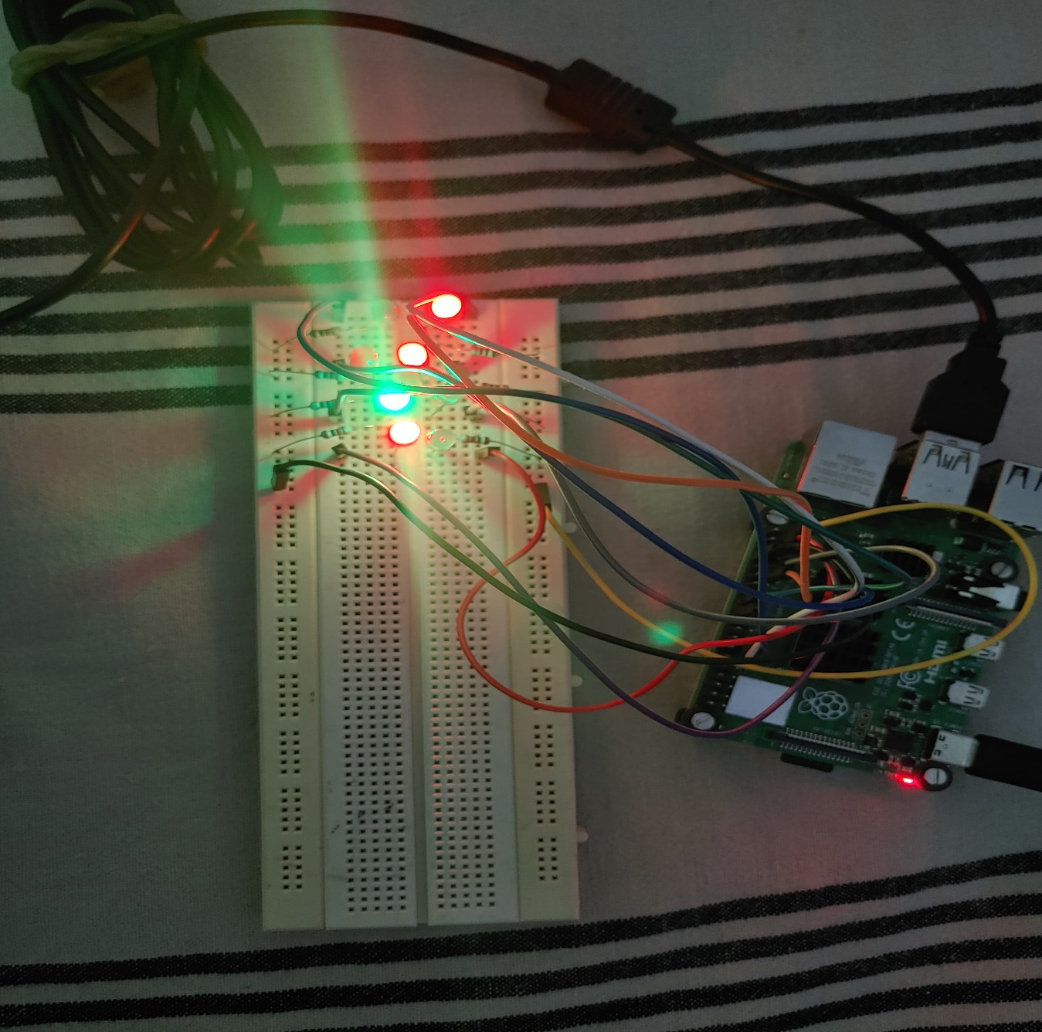
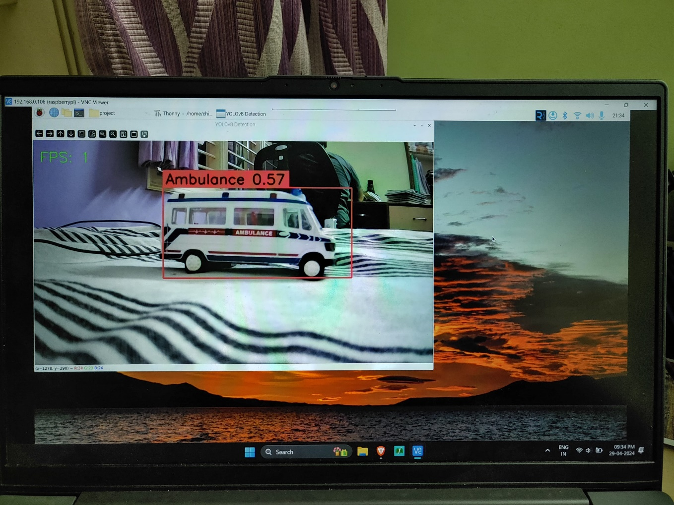
OUTPUT
Object Detection & Traffic Junction Simulation

Slide 21
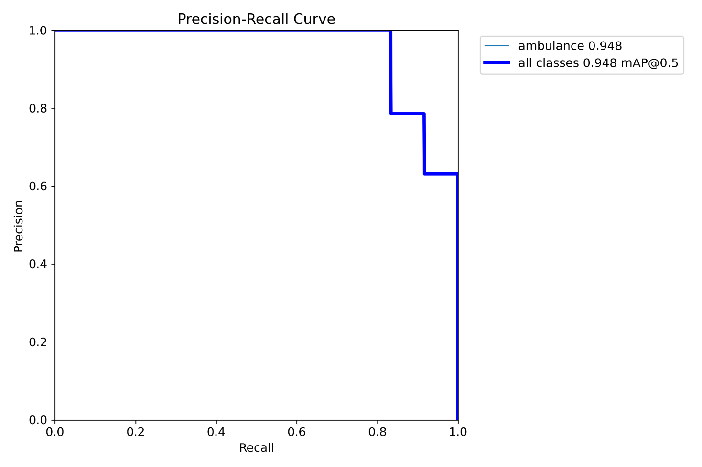
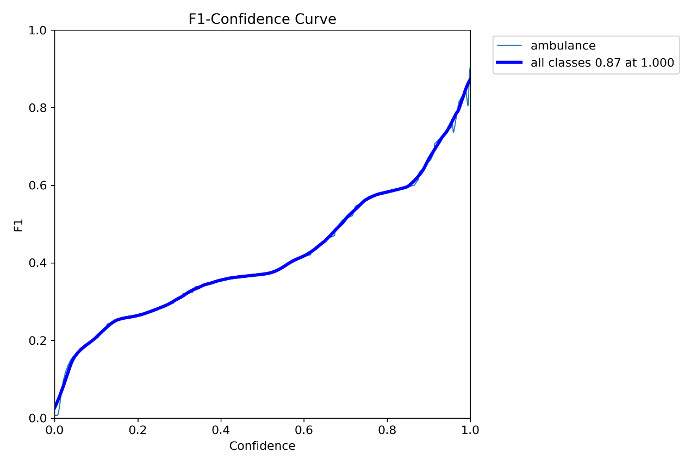
OUTPUT
The accuracy on our custom dataset trained model.

Slide 22
07
CONCLUSION

Slide 23
CONCLUSION
Real-time traffic monitoring using a camera and Raspberry Pi
Cost-effective solution with no additional hardware installations
Training the model with quick response for optimal signal switching
Minimizes congestion, reduces wait times, and enhances traffic efficiency in urban and rural areas.

Slide 24
08
LITERATURE SURVEY

Slide 25
LITERATURE SURVEY
[1.] “Ambulance detection using image processing and neural networks” by K Agrawal , M K Nigam , S Bhattacharya , Sumathi G – 2021
Video Clip Capture: Utilizes surveillance video clips for quicker processing compared to image-centric systems.
Truck Recognition: Identifies trucks from extracted images, directing recognized truck images to a pre-trained model.
Ambulance Priority: If a truck is confirmed as an ambulance, triggers traffic lights to turn green, prioritizing emergency vehicle movement.
[2.] “Smart Control of Traffic Light Using Artificial Intelligence” by Mihir M Gandhi, Devansh S Solanki, Rutwij S Daptardar, Nirmala Shinde Baloorkar. – 2020
Real-time Traffic Monitoring: Utilizes image processing and YOLO-based object detection on CCTV images to calculate live traffic density at intersections.
Vehicle Counting: The system counts cars, bicycles, buses, and trucks, providing key data for determining overall traffic density.
Signal Switching Algorithm: Adjusts green signal timers based on traffic density, ensuring efficient traffic flow. Limits on green signal time prevent lanes from being overlooked.

Slide 26
LITERATURE SURVEY
[3.] “Smart Ambulance and Traffic Controlling System” by Sudhakara H M, Girish H. R, Kumara Swamy N. R, J. Vinay Kumar4 and Sachin Kumar. M – 2020
The proposed system combines image acquisition, processing, feature extraction, and intelligent decision-making for real-time traffic management. Using cameras, it accurately classifies congestion, accidents, and roadblocks, providing dynamic solutions like traffic redirection. Real-world evaluations show effective performance, reducing congestion and enhancing urban safety through timely interventions.
[4.] "A Review: Smart Ambulance and Traffic Controlling System" by Sudhakara H M, Girish H. R, Kumara Swamy N. R, J. Vinay Kumar4 and Sachin Kumar. M
The proposed system involves the use of RFID technology, GPS tracking, and a cloud-based control system. It leverages real-time data to make traffic signal adjustments, allowing emergency vehicles to navigate through congested traffic efficiently. The paper also references related works in the field, discussing different approaches and technologies used in similar systems. The conclusion emphasizes the significance of the proposed system in reducing response time for emergency vehicles and ultimately saving lives. The authors discuss the integration of RFID, GPS, and cloud-based technologies to create a comprehensive and effective traffic management solution.

Slide 27
REFERENCES

Slide 28
[1] K Agrawal , M K Nigam , S Bhattacharya , Sumathi G, "Ambulance detection using image processing and neural networks" in International Conference on Recent Innovations in Arts, Science, and Technology(RIACT)- 2021
[2] Tugay Akca, Ozgur Koray Sahingoz, Emre Kocyigit, Mucahid Tozal, "Intelligent Ambulance Management System in Smart Cities" in 2020 International Conference on Electrical Engineering (ICEE) September 25-27, 2020, Istanbul, Turkey
[3]Arihant Kamdar, Jigarkumar Shah, "Smart Traffic System using Traffic ow models", in 2021 International Conference on Artificial Intelligence and Smart Systems (ICAIS) (2021)
[4] Sudhakara H M, Girish H. R, Kumara Swamy N. R, J. Vinay Kumar4 and Sachin Kumar. M, "Smart Ambulance and Traffic Controlling System" in International Journal of Engineering Research & Technology (IJERT) ISSN: 2278-0181– 2020
[5]Zoe Bartlett et al, “A Novel Online Dynamic Temporal Context Neural Network Framework for the Prediction of Road Traffic Flow” IEEE Access, vol.7, 2019.

Slide 29
[6] Z. Zhao. Chen, X.Wu, P. C. Chen, and J. Liu, ``LSTM network: A deep learning approach for short-term traffic forecast,'' IET Intell. Transp. Syst., vol. 11, no. 2, pp. 6875, Mar. 2017.
[7] P. Li, D. Wang, L. Wang, and H. Lu, ``Deep visual tracking: Review and experimental comparison,'' Pattern Recognit., vol. 76, pp. 323338, Apr. 2018.
[8] P. Wang and J. Di, ``Deep learning-based object classification through multimode fiber via a CNN-architecture SpeckleNet,'' Appl. Opt., vol. 57, no. 28, pp. 82588263, 2018.
[9] J. Zhao, Z. Zhang, W. Yu, and T.-K. Truong, ``A cascade coupled convolutional neural network guided visual attention method for ship detection from SAR images,'' IEEE Access, vol.6, pp. 5069350708, 2018.
[10] T. Pamula, ``Road traffic conditions classification based on multilevel filtering of image content using convolutional neural networks,'' IEEE Intel. Transp.Syst. Mag., vol. 10, no. 3, pp. 1121, Jun. 2018

Slide 30
THANKS!

